Slide 1
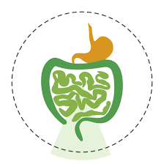
Lecture Title: Clinical Presentation of Inflammatory Bowel Disease
University of Basrah Al-zahraa medical college
Ministry of higher Education and Scientific Research
Module: Gastro-Intestinal Tract (GIT)
Semester: 4
Session: 8
Lecture Duration: 1h.
This Lecture was prepared by module Staff:
Dr. Wisam Hamza Dr.Nawal Mustafa Dr. Mayada Abdullah
Dr. Nada Hashim Dr. Amani Naama Dr. Ilham Mohammed
Dr. Jawad Ramadan Dr. Ansam Munathel
Dr. Farqad Alhamdani Dr. Zainab Ahmed
Dr. Nehaya Mnahi Dr. Haithem Almoamen
Dr. Sadik Hassan Dr. Raghda Al-Najjar
This Lecture was loaded in blackboard and you can find the material
Essentials of Pathophysiology. 3rd Edition, Lippincott Williams & Wilkins [2011];
Gastrointestinal system – crash course. 3rd Edition, Mosby [2008]
For more detailed instructions, any question, or you have a case you need help in,
please post to the group of session. Images are under Creative Commons Distribution.

Slide 2
University of Basrah Al-zahraa medical college
Ministry of higher Education and Scientific Research
Learning Objectives :- LO (11-15)
Regarding INFLAMMATORY BOWEL DISEASE:-
(LO-11) : Describe the clinical presentations.
(LO-12) : Recognize macro- and microscopical features.
(LO-13) : Describe diagnostic difficulties.
(LO-14) : Describe endoscopic and radiological features.
(LO-15) : Describe treatment options.

Slide 3
Overview
University of Basrah Al-zahraa medical college
Ministry of higher Education and Scientific Research
LO: 11-15
Inflammatory bowel disease affects 0.3% of the population.
Two main types; Ulcerative colitis and Crohn disease.
Both follow a prolonged, often relapse and remission course.
Both may be a debilitating illness.
Crohn disease:-
is less prevalent than Ulcerative colitis.
Common in western countries.

Slide 4
University of Basrah Al-zahraa medical college
Ministry of higher Education and Scientific Research
Aetiology
LO-11-12
Females more than males.
Commonly 20—40 years old.
The exact cause is unknown.
Factors: genetic, infection, immunological and smoking HOW?
Ulcerative Colitis
Females equal to males.
Commonly 20—40 years Caucasians.
The exact cause is unknown.
Factors: genetic (twins), environmental (smoking and diet HOW?
Crohn Disease

Slide 5
University of Basrah Al-zahraa medical college
Ministry of higher Education and Scientific Research
Pathology
LO-12
Chronic inflammation of the mucosa.
Principally affects the rectum and sigmoid colon.
Limited to mucosa.
Ulcerative Colitis
Chronic inflammation of whole bowel layers.
Occur anywhere in the GI tract.
Commonly, terminal ileum and proximal colon.
Crohn Disease

Slide 6
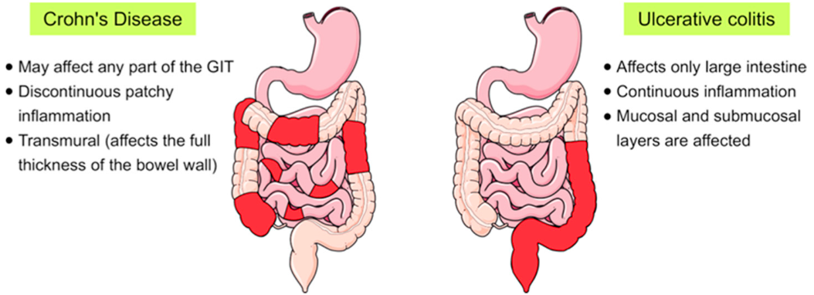
University of Basrah Al-zahraa medical college
Ministry of higher Education and Scientific Research
Pathology
LO-12

Slide 7
University of Basrah Al-zahraa medical college
Ministry of higher Education and Scientific Research
Clinical Features
LO-11
Bloody mucus diarrhea and pain.
Extra-intestinal: Eye, skin and joints.
Complications: Bleeding, perforation, toxic megacolon
and cancer.
Ulcerative Colitis
Depend of the GI site affected.
Ileum: Abdominal pain and diarrhea, malabsorption (B12), anemia and weight loss.
Colon: SAME TO ULCERATIVE COLITIS, in addition to to constitutional symptoms such as malaise, anorexia and weight loss.
Extra-intestinal: Eyes, skin and joints.
Complications: Stricture, fistula and perforation.
Crohn Disease

Slide 8
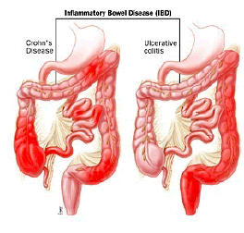
University of Basrah Al-zahraa medical college
Ministry of higher Education and Scientific Research
Clinical Features
LO-11

Slide 9
University of Basrah Al-zahraa medical college
Ministry of higher Education and Scientific Research
Diagnosis
LO: 13-14
Ulcerative Colitis
Contrast Study: shortened narrowed colon, loss
of haustrations, 'lead-pipe' colon
Crohn Disease
Contrast Study: altered mucosal pattern, 'string
sign', deep penetrating ulcers

Slide 10
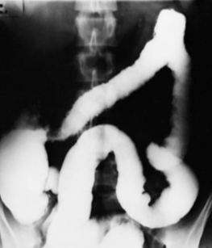
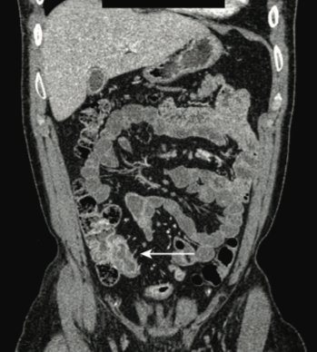
University of Basrah Al-zahraa medical college
Ministry of higher Education and Scientific Research
Diagnosis
LO: 13-14
Contrast Study
Ulcerative Colitis
Crohn Disease

Slide 11
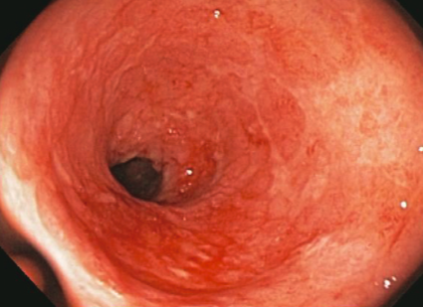
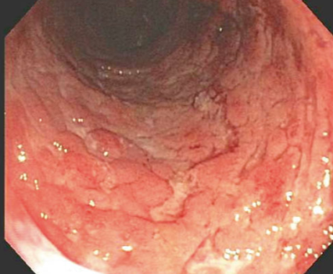
University of Basrah Al-zahraa medical college
Ministry of higher Education and Scientific Research
Diagnosis
LO: 13-14
Endoscopy
Ulcerative Colitis
Crohn Disease

Slide 12
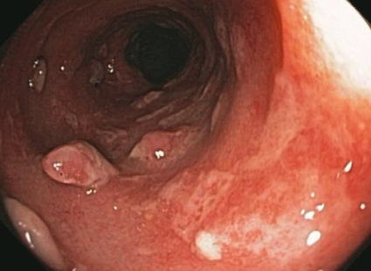
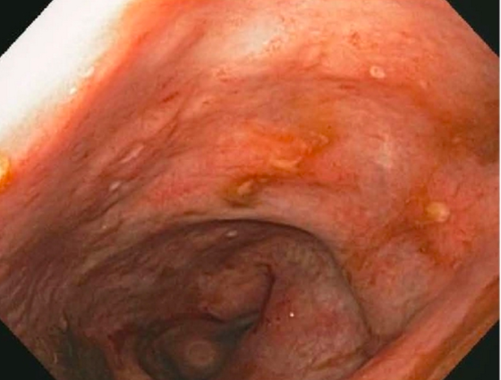
University of Basrah Al-zahraa medical college
Ministry of higher Education and Scientific Research
Diagnosis
LO: 13-14
Endoscopy
Ulcerative Colitis
Crohn Disease

Slide 13
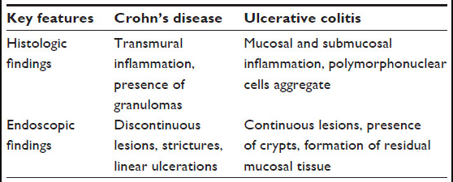
University of Basrah Al-zahraa medical college
Ministry of higher Education and Scientific Research
Diagnosis
LO: 13-14

Slide 14
University of Basrah Al-zahraa medical college
Ministry of higher Education and Scientific Research
Management
LO-15
Ulcerative Colitis
Crohn Disease

Slide 15
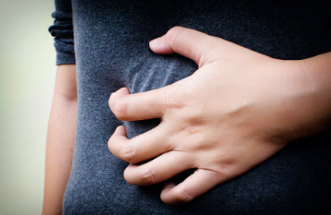
University of Basrah Al-zahraa medical college
Ministry of higher Education and Scientific Research
Management
LO-15
Ulcerative Colitis
Medical: Steroids, Aminosalicylates and Azathioprine
Surgical: Resect the colon.
Crohn Disease
Similar to ULCERATIVE COLITIS.
Others: diet and metronidazole.
Surgical: Resect the affected bowel.

Slide 16
University of Basrah Al-zahraa medical college
Ministry of higher Education and Scientific Research
Comparison
LO: 11-15
 | Ulcerative Colitis | Crohn Disease
Pathology | Always rectum and sigmoid colon. Mucosa only, superficial ulceration, pseudopolyps. Crypt abscesses. | Any part of gastrointestinal tract, skip lesions Full-thickness (hosepipe), fissures, mesentery involved. Non-caseating granulomas .
Clinical, Extra intestinal, Complications | Rectal bleeding, diarrhoea. Iritis, arthritis. Haemorrhage, perforation, toxic megacolon, carcinoma. | Abdominal pain and mass, malaise, diarrhoea, perianal disease. Erythema nodosum Pyoderma gangrenosum Stricture, fistulae
Radiology: Contrast Study | Shortened narrowed colon, loss of haustrations, 'lead-pipe' colon. | Altered mucosal pattern, 'string sign', deep penetrating ulcers.
Management | Sulfasalazine, steroid, azathioptine. Panproctocolectomy and ileostomy. | Dietary manipulation. Sulfasalazine, metronidazole, steroids, azathioprine. Resect affected segment, stricturoplasty.

Slide 17
To Sum Up
University of Basrah Al-zahraa medical college
Ministry of higher Education and Scientific Research
Inflammatory Bowel Disease:-
Both follow relapse and remission course
Ulcerative disease:
Mainly large bowel
Not full thickness.
Presents with diarrhea, pain and blood loss
Managed medically and surgically
Crohn disease:
Any part of the gut
Full thickness of the wall
Presents with diarrhea, pain and malabsorption
Managed medically and surgically

Slide 18
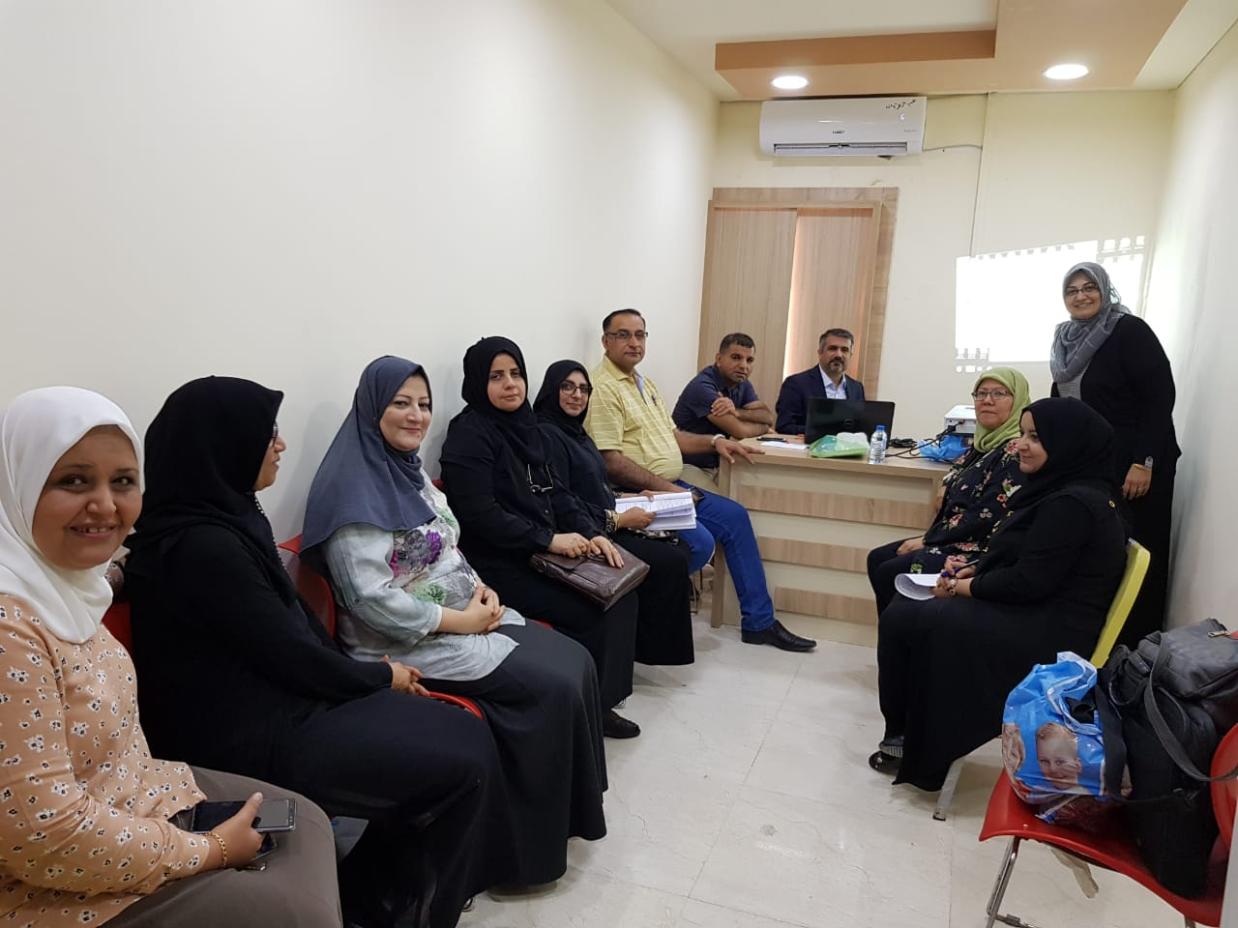
Thank you
University of Basrah Al-zahraa medical college
Ministry of higher Education and Scientific Research
Wishing you all the best in the GI Module
?

